Slide 1
Changing Gear
Creating the life you want after a full on career
Jan Hall and Jon Stokes

Slide 2
Jon Stokes is a psychologist and a member of St Antony’s College, Oxford University. Jan hall is a successful business leader. She now advises CEOs. She worked with Spencer Stuart, the head hunting firm.

Slide 3
The word career comes from the French carrier meaning a road or a path, and implies more or less straight on direction.

Slide 4
Careers are not that simple – we take diversions, get lost, return to a different main road. There maybe periods of being out of work, whether by choice or not.

Slide 5
If you are reading his book, you are likely to be someone who has a high drive to achieve, with a consequent fear of failure and thus a need to be in control.

Slide 6
Changing Gear looks at why work is such an important part of a persons identity, and how challenging it can be when its time to change gear, whether to explore a new path or take a step back from our careers entirely.

Slide 7
At some point after the age of fifty, many people begin to feel a lack of certainty about how the world will work out for us, as well as for our families, friends and communities.

Slide 8
This book speaks to those who have broadly loved their jobs and to a great extent, been defined by what they do.

Slide 9
This work persona or sense of identity can become who they are , both to those around them and even more to themselves.

Slide 10
Working and being part of an organization provides us with a sense of purpose, value and community. Losing that, perhaps for people who have invested perhaps too much of themselves in work, can be a challenge.

Slide 11
However, for those who see work as a part of their purpose, being faced with reconsidering or expanding their sense of self outside their work role can be very daunting.

Slide 12
Not only does this mean losing their day to day routine, it also brings into question their status in their particular community, their ‘power’ their sense of being needed, their relevance and their legacy.

Slide 13
After 40, and especially after 50, only those capable of total denial still think they are young. However, they also rarely think of themselves as old.

Slide 14
For some the choice to leave a role is theirs to make, for others, factors beyond their control make the choice for them.

Slide 15
The traditional mid life crisis, in your early forties typically entails accepting who you are, that your personality, strengths and weaknesses are unlikely to change very significantly and that some of your aspirations simply wont be fulfilled.

Slide 16
The solution is to make the best of what you have, rather than continuing to dream about what you might be capable of.

Slide 17
Work can seem straightforward because it is so familiar, but many have not considered what it has shielded them from.

Slide 18
The problem with a life built on achievement is that the alternative may seem like failure, and so to change course feels an impossibility.

Slide 19
William Bridges makes a distinction between change and transition. Things change but people transition.

Slide 20
The real issue for most CEOs is that they cannot envisage how life will be without the trappings of a CEO role.

Slide 21
Not only doing the CEO job, but the respect, and in truth, the power that is bestowed on them and access to other leaders and influencers, a perk you enjoy when you are a CEO.

Slide 22
All CEOs by and large seek and enjoy power. CEOs typically dislike or are relatively intolerant of feelings of vulnerability and helplessness.

Slide 23
CEOs are unable to recognize it in themselves and see it in others , usually with disapproval.

Slide 24
When a C EO leaves a role, they feel vulnerable. The loss of power in organizations is frequently dramatic in reality as well as in feelings. New coalitions develop without you.

Slide 25
As soon as someone announces a departure at any level, others are eager for the benefits that are up for grabs, and can show a cruel disregard of how it might feel to the person who is leaving.

Slide 26
We are prone to the assumption that organizations are there to look after us like a aren’t, ignoring the fact that organizations are driven by the logic and mechanics of marketplace survival, with limited capacity for human feeling.

Slide 27
For most of us, the demands of our daily lives leave little room for introspection or reassessment.

Slide 28
In weakness there is strength, achieving grace in changing gear.

Slide 29
A child’s response to powerful parental needs about who they should be and how they should behave can produce either rebellion or conformity.

Slide 30
Generally , we have at least two selves – a private self, which we only show to friends and family, and a public self, which we express more widely, and especially in the workplace.

Slide 31
The private life and personal needs take second place to the potentially infinite demands of the workplace and career.

Slide 32
This generally happens slowly, and largely unconsciously, so that the person themselves become confused between their more personal needs and their ambitions at work.

Slide 33
Knowing the difference between bearable and unbearable levels of stress is a necessary condition for thriving in challenging professions.

Slide 34
We all reach a stage when we have to make choices. At Harvard Business School, students are asked to outline their ambitions against three priorities – fame , fortune and family. It is a soul searching moment that implies future sacrifice.

Slide 35
The real question is how can people who gradually become consumed by their work retain their perspective on their whole selves?

Slide 36
Forced retirement or redundancy are sadly an all too familiar part of life. There are many reasons it can happen, bit whatever the reason, the adjustment required in your domestic and professional life is huge.

Slide 37
Inevitably the redundancy or forced retirement prompts questions about your identity and relationship with yourself, as well as with others.

Slide 38
Ambitious people love work for the power and status it brings. Power goes to the head, power over others seems inexorably to lead an inflated view of oneself.

Slide 39
Person ( who I am ) gets confused with role ( the authority and resources my role gives me access to).

Slide 40
Those in power gradually become insulated from reality, they mistake the powers conferred by the role with their own personal powers, and develop and inflated sense of their own importance.

Slide 41
The sense of importance that work provides is seductive, and the relative predictability of command and control work relationships, compared to more intimate and exposing personal ones, can all become an addictive retreat from any sense of vulnerability.

Slide 42
Organizations provide human beings with a container for the expression and working through of a range of emotions.

Slide 43
Organizational life can sometimes feel like a giant soap opera, but then it is these very same emotions that account for why soap operas can have such an addictive hold on us.

Slide 44
Is willful blindness a sign of neglect, of just caring enough- or maybe even of caring too much?

Slide 45
Chuck Palahniuk says “ You realize that our mistrust of the future makes it hard to give up the past”

Slide 46
Imagining the future or potential futures requires doing a number of things that are not compatible with busy lives and arguably , do not come naturally to most people.

Slide 47
In order to embrace the future, there is a necessary acceptance of letting go of the present. This does not mean not living in the present, but it does mean taking some time in the present to think about your own past as well as future.

Slide 48
Discovering a new passion, or rediscovering an existing one – and with this a whole other sense of yourself – can be, on the other hand, wonderful, on the other, a dilemma.

Slide 49
Sometimes life does not deal us the hand we want. Sometimes, in fact, it deals us a hand we do not want. The acceptance of this can follow quite a complicated route.

Slide 50
Is it possible to care too much? Those that help others place a high value on their ability to feel that they have helped in a tangible way.

Slide 51
Some leaders fight the system and empower people. They do not recognize that as they move up higher in the system, the more they become a part of it.

Slide 52
In every institution the leader needs to manage the gap between needs and resources.

Slide 53
Those who have achieved a degree of success in their careers have usually committed a significant amount of time to it, and to some extent, are defined by it, either personally, or by others or both.

Slide 54
Changing our behavior is notoriously difficult. How often our new year resolutions last for a few weeks only !

Slide 55
Full time employment has many functions beyond just economic returns - it regulates and structures our day, it provides an identity, it structures interpersonal relationships, and provides a sense of value and self worth.

Slide 56
To have work of some kind is crucial. Loving and being loved is part of the foundation of our mental health. Losing your job can be as traumatic as losing a loved one.

Slide 57
To be without work deals a double blow. For the unemployed person, there is not only the loss of being exclude from the wider world and the freedom that earning one’s own living provides, but also of a basic opportunity of reassurance about one’s worth.

Slide 58
The best way to make a change is to have a positive visual picture of the desired future state in concrete terms. Rather than saying lose weight, imagine the flatter stomach and stronger abdominal muscles.

Slide 59
Behavior change is possible when you are an optimist.

Slide 60
An optimist and a forgiving mindset helps you deal with the inevitable setbacks of change, regarding these as just a single event and part of the process whereas a critical or rigid person might assume setbacks as proof of the impossibility of change.

Slide 61
Optimism is a growth mindset that thrives on challenge and sees failure not as a personal matter but as something to be overcome by attitude and abilities.

Slide 62
Self limiting beliefs that hamper change
All or nothing
Jumping to conclusions
Catastrophizing
Minimizing

Slide 63
Some helpful habits to embrace change
Focus on the positive , not the negative
Break problems into smaller pieces to give a sense of achievement
Seeking help when you need it
Regarding mistakes as opportunities to learn

Slide 64
Some unhelpful habits about change
Focusing on what went wrong
Being unforgiving of mistakes
Not building positive experiences and confidence boosters in your routine
Fearing failure
Taking a rigid attitude

Slide 65
Those who have been successful have often become so by developing one aspect of themselves – such as being knowledgeable or a provider of solutions to others.

Slide 66
We tend to suffer from a strategic persistence- carrying on with the same approaches to problem solving that have been successful for us in the past.

Slide 67
This is true in organizations too. The paradox of success in business is that when a company is successful, it tends to persist with existing strategies, and there is a tendency to double down on the same strategies when things change.

Slide 68
Striving for excellence is commendable but it is frequently focused on opinion of others.

Slide 69
High achievement is driven by a positive desire to excel, but also a fear of being seen as a failure.

Slide 70
3 types of perfectionists
Strivers – constantly trying to live up to their own high standards, and perpetual victims of their own high standards
Zealots – expecting perfection of others
Idealists – struggling to live up to an image of what others have of them

Slide 71
Having a powerful role at work can mean that you are used to getting your own way. The psychologist Dacher Keltner argues that those in power often lose their better qualities and some completely lose touch with their better side.

Slide 72
Success can feed the dark side – the desire to have power over others , and the need to be center stage and viewed as more successful than others.

Slide 73
Relationships almost always involve a degree of mixed feelings. Things are never perfect al the time and most relationships are occasionally frustrating.

Slide 74
The psychologist Sonja Lyubomirsky argues that 50 % of your happiness is genetic, ten % is based on life circumstances and 40 % is based on your actions.

Slide 75
Life is a choice. It is your life, choose consciously, choose wisely and choose honestly, Choose happiness

Slide 76
You are your life’s CEO
How am I performing as the CEO of my own life?
To what extent am I living my own purpose?
What might I need to say Yes or No to?
How am I balancing the important and unimportant, and the urgent and not so urgent in my life?
What other activities might I consider?

Slide 77
Being the best self you can be is arguably a bit of a cliché, but nonetheless, it is a worthy goal.

Slide 78
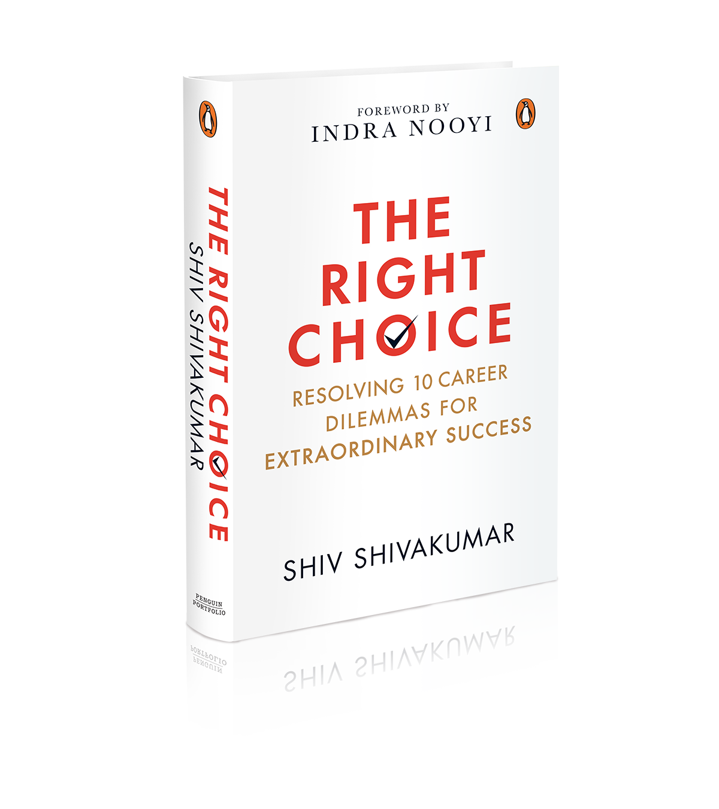
Do order your book
http://bit.ly/TRCSHIVAKUMAR

